Slide 1
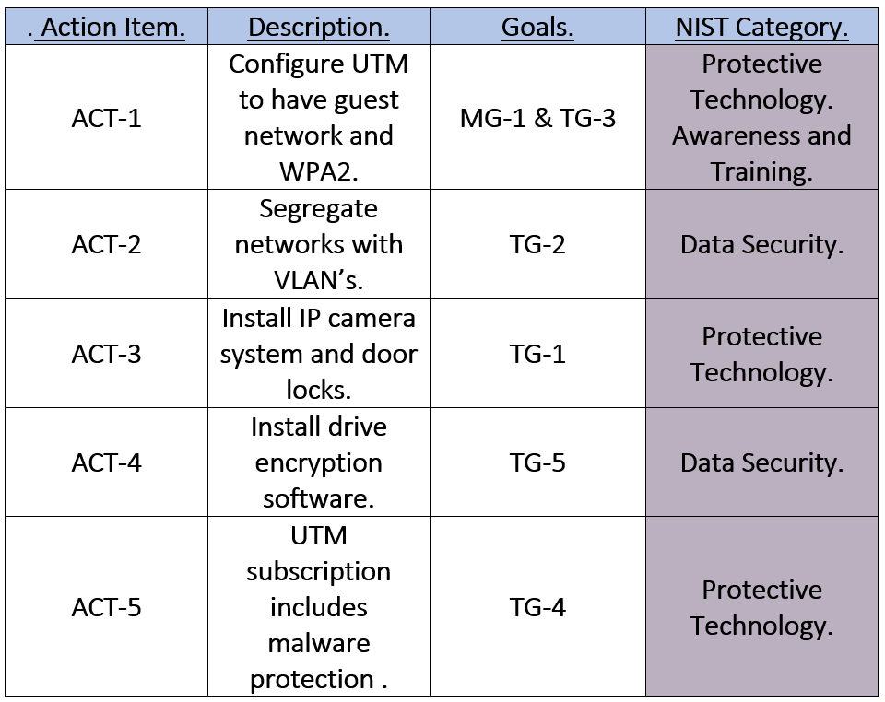
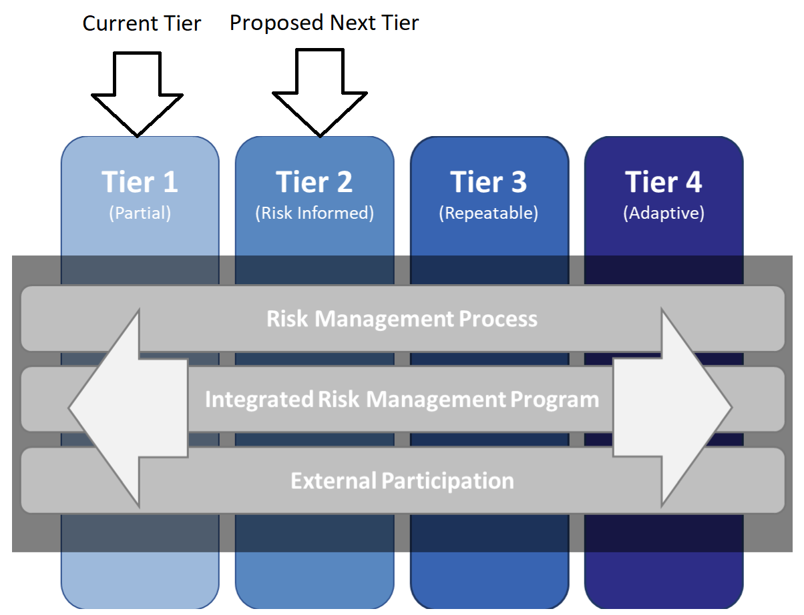
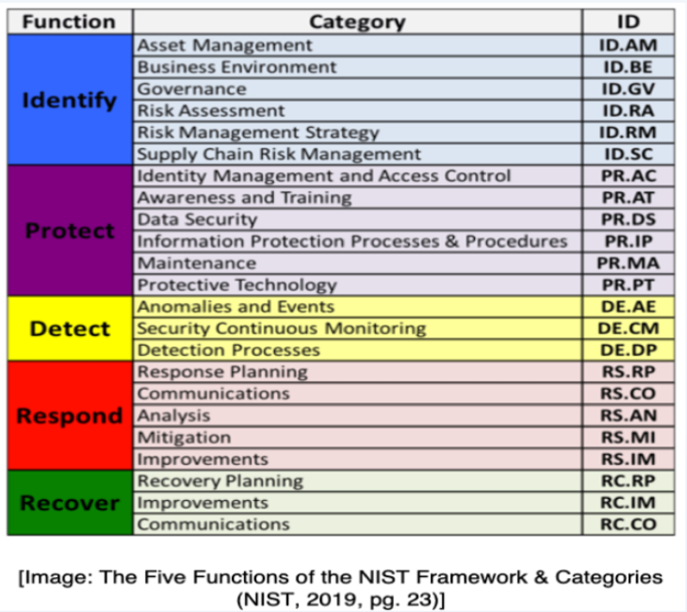
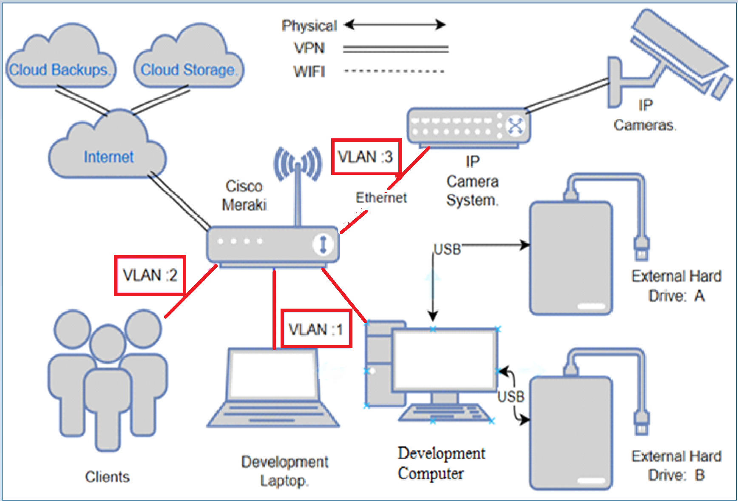
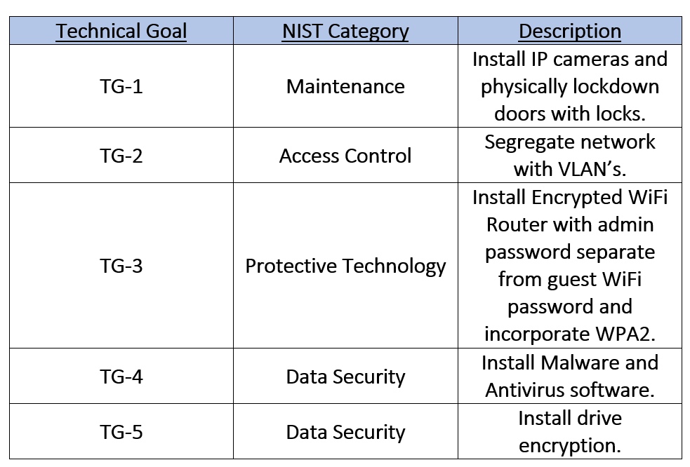
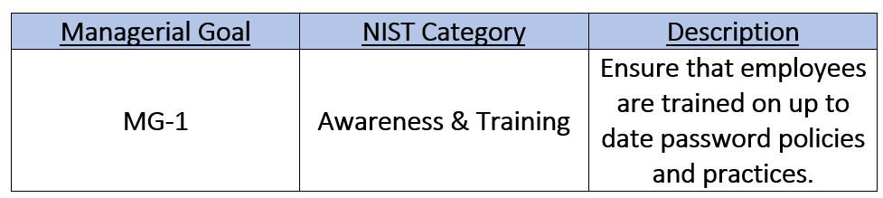

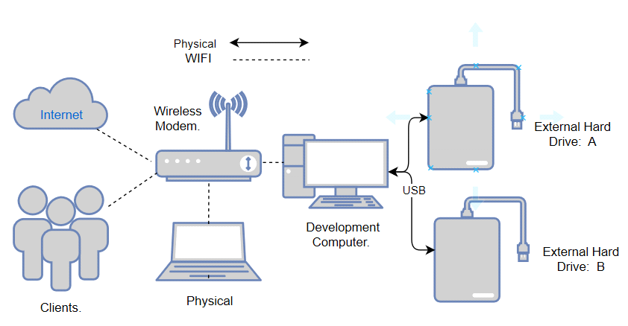
A Network hardening and data breach mitigation of an audio engineering studio Fall 2020
Team/Students: ISEC690 Team 1 | Babatunde Somade and Eric Webb | Business Advisor: Figgy, Z.| Professor: Dr. Yair Levy, Professor of IS & Cybersecurity
Introduction
Today’s business world lives off the production and manipulation of proprietary data. When information is the main product, it is imperative that it is kept safe (Leyshon, 2014). While keeping the product secure, businesses must still align themselves with best practices to mitigate risk (Jordan, 2012). Exposing their data or leaving it vulnerable to a breach could lead to a catastrophic business impact while simultaneously daunting the company's reputation. Loss of revenue and damage to reputation are some of the effects of a security breach. Gone are the days were small business were overlooked by bad actors, in fact, small business generates twice as much innovations and have more intellectual property than larger organization (Bhattacharya, 2015).
Recognize and Define a Problem
For many audio engineering studio's, digital attacks are a serious risk. Many clients within these organizations depend on the security and privacy of their projects in order to be successful. Most audio studios are small businesses with limited resources, no dedicated skilled IT staff, and basic to no security features (Bhattacharya, 2015). When compared to large businesses that have dedicated security teams, audio studios are more suspectable to data theft and network intrusion (Bhattacharya, 2015).
Organizational Facts
National Institute of Standards and Technology (NIST) discovered some vulnerabilities that could be easily exploited by bad actors if not properly remediated (Sedgewick, 2014).
Physical Security issues
Studio doors does not have locks on them. Office building door has lock but once in a perpetrator has access to recording equipment.
Production computer should be locked away. Guest/Customers should not have physical access to them.
No Security system in place to keep a record of access to the facility.
Network Security issues
Business has a flat network for all traffic. Production network is the same as guest network, no segregation.
Guest connected to the WiFi can access the routers configuration.
Business uses WiFi Protected Access (WPA) for security.
Business does not use a Virtual Private Network (VPN) or Proxy.
No network firewall, Intrusion Detection System (IDS), or Intrusion Prevention System (IPS).
Computer Security issues
Production computer does not encrypt proprietary data on its local machine.
Ports and Drives are not locked down from external hardware.
Operation Security issues
Client only pushes backups to 3rd party but can only use as a restore point, cannot reference live data remotely. Can’t access data in a flash in case of an emergency.
Project Scopes and Goals
Recommended Action Plan
Risk Management Analysis
Anticipated Results
Create segregated networks between production, guest, and IP camera system environments.
This increases security and prevents guest from accessing the production or CCTV network.
Increase security from WPA to WPA2.
This increases security because WPA is relatively weak and be cracked by a brute force attack. WPA2 increases the WiFi security posture.
Safer communication to outside world.
This is done through the VPN and Proxying capabilities of the Meraki network appliance. This prevents eavesdropping and using the Proxy will mask the packets hops out to the world.
Data Encrypted on Local Machine.
This prevents data theft if a bad actor were able to gain access to the computer. The files are encrypted and useless without the decryption key.
Proposed Costs
Conclusion
This initiatives focus was to harden the network and raise the security posture of this audio engineering facility. Since there was little to no cybersecurity coordination, this audio engineering studio had a NIST tier level of 1. Physical security can be increased with the installation of door locks and a private IP camera network. Network security can be improved with the introduction of a Network Security Appliance (NSA), in this case being a Meraki all in one device. This will increase security through its abilities to provide a VPN, segregating networks, proxying capabilities, and improving WiFi security from WPA to WPA2.The Operation security of this business will be further developed to include disk encryption software to protect data at rest and to also include secure connections to a hot cloud drive for safer content management. Once these objectives are completed, this business will then have a stronger security posture and higher level of consciousness when it comes to their cyber awareness. It will also provide enough resources to adequately accommodate their Cybersecurity needs. After these changes have been made this audio engineering studio will have a new higher proposed NIST tier level of 2.
References
Bhattacharya, D. (2015, September). Evolution of cybersecurity issues in small businesses. In Proceedings of the 4th Annual ACM Conference on Research in Information Technology (pp. 11- 11).
Jordan, S. (2012). Defense in depth: Employing a layered approach for protecting federal government information systems.
Sedgewick, A. (2014). Framework for improving critical infrastructure cybersecurity, version 1.0 (No. NIST-Cybersecurity Framework).
Leyshon, A. (2014). Reformatted: Code, networks, and the transformation of the music industry. Oxford University Press, USA.
Lihong, Y., & Zhiguo, W. (2018, September). Research and Design of Multi Dimension Protection System for Data Security in Cloud Computing Environment. In Proceedings of the 2018 International Conference on Information Hiding and Image Processing (pp. 12-15).
Ma, S., Lee, K. H., Kim, C. H., Rhee, J., Zhang, X., & Xu, D. (2015, December). Accurate, low cost and instrumentation-free security audit logging for windows. In Proceedings of the 31st Annual Computer Security Applications Conference (pp. 401-410).
McDermid, D. C., Mahncke, R. J., & Williams, P. A. (2009). Challenges in Improving Information Security Practice in Australian General.
Monshizadeh, M., Naldurg, P., & Venkatakrishnan, V. N. (2014, November). Mace: Detecting privilege escalation vulnerabilities in web applications. In Proceedings of the 2014 ACM SIGSAC Conference on Computer and Communications Security (pp. 690-701).
Xie, R., & Gamble, R. (2013, January). An architecture for cross-cloud auditing. In Proceedings of the Eighth Annual Cyber Security and Information Intelligence Research Workshop (pp. 1-4).
Current NIST Tier Level is: 1
Although this organization showed some limited knowledge about cybersecurity there was little to no cybersecurity coordination. Making it quite accessible and starting it at a NIST Tier of one.
Proposed Target NIST Tier Level is: 2
Within this security overhaul, this organization will contain management approved processes for deployment of security constructs, will have a somewhat high level of awareness of its own security posture, and have enough digital and physical resources to maintain a loosely coordinated security posture. Raising it to a NIST Tier level to a 2.
Table 3: Action Plan
 | Item/Service | Who Installs | ACT# | Number of Items | Total
CCTV | Reolink IP Camera System. | Contractor | ACT3: IP Camera System | 1 | $1500
Data Encryption | Mac OS Utility Tool. | Internal | ACT4: Encryption tool | 1 | $100
Physical Control | Locks with codes. | Internal | ACT5: Door locks | 2 | $300
Network Implementation | Cisco Meraki MX450 | Contractor | ACT1&2: UTM | 1 | $4000
GRAND TOTAL: $5900
Network Topology
This network is originally a flat network by design with no segregation of data in between. With the new Meraki the plan is to incorporate smart switching capabilities along with added confidentiality by a VPN.
Current Topology
Proposed Topology
Table 4: Risk Management Analysis
Table 1: Technical Goals
Risk Rank | Risk Type | Risk Description | Likelihood of Occurrence | Impact of Organization | Proposed Action Item
1 | Data Breach | Financial loss if intellectual property is stolen. | High | High | ACT1: Configure UTM access control policy to prevent unauthorized users from accessing data.
2 | Network Breach | Bad actors can gain access to business network due to lack of security measures. | High | High | ACT2: Using the UTM device, set up a VLAN for guest and production network traffic. Use a captive portal for guest access. Configure VPN for all traffic.
3 | Physical Breach | Lack of visibility and proper physical security controls. | Medium | High | ACT3: Install IP camera system and door locks to prevent unauthorized access and provide a record of physical access.
4 | Lack of Encryption | Files are unencrypted. Physical access to a workstation means full data access. | Medium | High | ACT4: Install encryption software on all workstations and backup the key.
5 | Malware and Ransomware | Malwares and Ransomware are threats to the availability of the business data . | Medium | High | ACT5: UTM subscription includes malware protection software for workstations.
The main goal of this project is to redesign the network architecture and help harden the company’s network security. This proposal will cover the current network topology and the propose remediation for this audio engineering studio. The topics covered includes the Local Area Network (LAN), Data storage (transit and at rest) and Malware and Ransomware protection. By following the principle of layered security and defense in depth (Jordan, 2012), the proposed solution will ensure Confidentiality, Integrity, and Availability of the business network infrastructure and intellectual property. The goals can be broken into the following categories. Technical Goals: Install new Unified Threat Management (UTM) device and physical security controls, this is illustrated by Table 1: Technical Goals. Managerial Goals: Educate employees on top IT security practices to help reduce the likely hood of a security incident. This is illustrated by Table 2: Managerial Goals.
Table 2: Managerial Goals
Center for Information Protection, Education, and Research (CIPhER) https://InfoSec.nova.edu/
College of Computing
And Engineering (CCE)

